Slide 1
Department of CSE
COURSE NAME: Data science
COURSE CODE: 24AD3107
Topic:
Seaborn Basics and Styling Concepts
Session – 5&6

Slide 2
AIM OF THE SESSION
To familiarize students with the basic concept of Seaborn Library and its Styling Components in Python.
INSTRUCTIONAL OBJECTIVES
This Session is designed to: Introduction to Basics of Seaborn and its styling components.
LEARNING OUTCOMES
At the end of this session, you should be able to: have knowledge on seaborn library and styling concepts and plotting using seaborn

Slide 3
Key Concepts
SESSION INTRODUCTION
Introduction to Seaborn
Styling Concepts of Seaborn
Plotting using Seaborn.

Slide 4
What is Data Visualization?
Data visualization is the practice of translating data into visual contexts, such as a map or graph, to make data easier for the human brain to understand and to draw comprehension from. The main goal of data viewing is to make it easier to identify patterns, styles, and vendors in large data sets.
Data visualization tools provide a way to present these figures and graphs.
Often, it is essential to analyze massive amounts of information and make data-driven decisions.
  converting complex data into an easy to understand representation

Slide 5
Introduction to seaborn
Seaborn is a Python library for making statistical graphics in Python. It builds on top of matplotlib and integrates closely with pandas data structures.
Seaborn helps you explore and understand your data, It has plotting functions operate on data frames and arrays containing whole datasets and internally perform the necessary semantic mapping and statistical aggregation to produce informative plots,
Seaborn Setup
  Installation: Supported Python versions: Python 3.7+
  Mandatory dependencies Python Libraries: numpy, pandas, matplotlip
  Optional Dependencies Python Libraries: stats models, scipy and fast cluster
  Installation: # pip install seaborn
  Import: import seaborn as sns
Creator is Michael Waskom
First version v0.12.0 released in September 2022

Slide 6
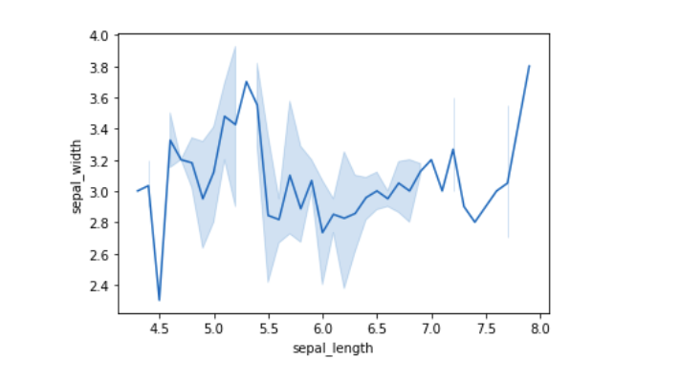
Seaborn:
Seaborn is a library mostly used for statistical plotting in Python. It is built on top of Matplotlib and provides beautiful default styles and color palettes to make statistical plots more attractive. It divides the plots into the following categories.
Relational plots: This plot is used to understand the relation between two variables.
Categorical plots: This plot deals with categorical variables and how they can be visualized.
Distribution plots: This plot is used for examining univariate and bivariate distributions
Regression plots: The regression plots in Seaborn are primarily intended to add a visual guide that helps to emphasize patterns in a dataset during exploratory data analyses.
Matrix plots: A matrix plot is an array of scatterplots.
Multi-plot grids: It is a useful approach to draw multiple instances of the same plot on different subsets of the dataset.
import seaborn as sns
data = sns.load_dataset("iris")
sns.lineplot(x="sepal_length", y="sepal_width", data=data)
Sns.set_style(style=darkgrid)

Slide 7
Seaborn Distribution Plots:
Seaborn Visualizing Distributions:
using Seaborn in conjunction with Matplotlib, you can create a wide range of customized distribution plots that are both visually appealing and informative.
Seaborn visualization functions :
1- Axes-level functions include:
histplot()
kdeplot()
2- figure-level funcations:
displot()
jointplot()
pairplot()
Seaborn Regression Plots
the regression plots in seaborn primarily intended to add a visual guide that helps to emphasize patterns in a dataset during exploratory data analyses.
Functions for drawing linear regression models
1- regplot function: used for Plot data and a linear regression model fit.
Produces a scatter plot complemented by a regression line.
2- lmplot function: used for Plot data and regression model fits across a FacetGrid.
Built upon regplot function, Advanced and comprehensive.

Slide 8
Using Seaborn Styles:
Seaborn comes with some customized themes and a high-level interface for customizing the looks of the graphs.
Style Configurations in Seaborn:
- Use sns.set() to activate Seaborn's built-in style configurations
- Set a specific theme using sns.set_style().
- Sometimes plots are improved by removing elements
Changing Figure Aesthetic
set_style() method is used to set the aesthetic of the plot. It means it affects things like the color of the axes, whether the grid is active or not, or other aesthetic elements. There are five themes available in Seaborn.
darkgrid
whitegrid
dark
white
Ticks Syntax: set_style(style=None, rc=None)

Slide 9
Color Usage in Seaborn:
Seaborn allows color assignment to plots using matplotlib color codes.
Use set_palette() to define a specific color palette in Seaborn.
Use sns.color_palette() retrieves the active palette.
Circular colors: Ideal for unordered data.
Diverging colors: Suited for data where both low and high values are significant.
Sequential colors: Designed for data with a consistent range, from high to low values.

Slide 10
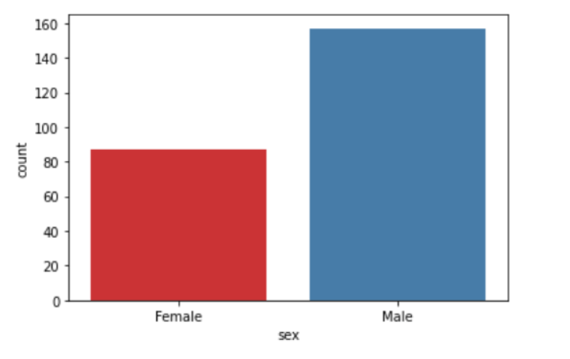
Using color palette:
import matplotlib.pyplot as plt
import seaborn as sns
import pandas as pd
#loading the dataset 'tips'
df=pd.read_csv("/content/tips.csv")
#plotting the graph
sns.countplot(x='sex', data=df, palette='Set1')
plt.show()
When you use palette="Set1" in Seaborn, you are using a qualitative (categorical) color palette.
It is best when your data consists of distinct categories with no numerical order.
If by “unordered data” you mean categories such as Apple, Banana, and Orange, use a qualitative palette such as sns.color_palette("Set2") rather than a circular palette.

Slide 11
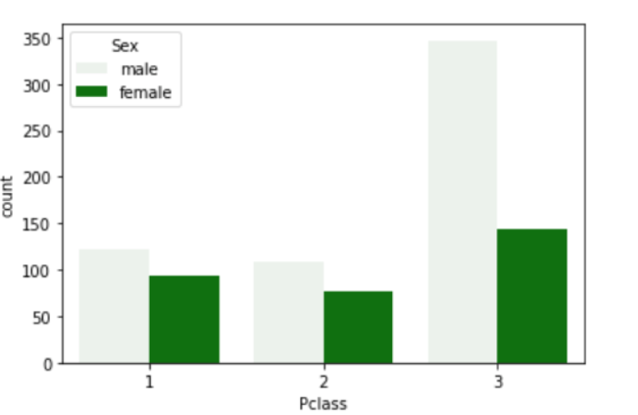
Using color parameter:
import matplotlib.pyplot as plt
import seaborn as sns
import pandas as pd
#loading the dataset 'train'
df=pd.read_csv("/content/train.csv")
#plotting the graph
sns.countplot(x='Pclass',hue='Sex', data=df, color='green')
plt.show()

Slide 12
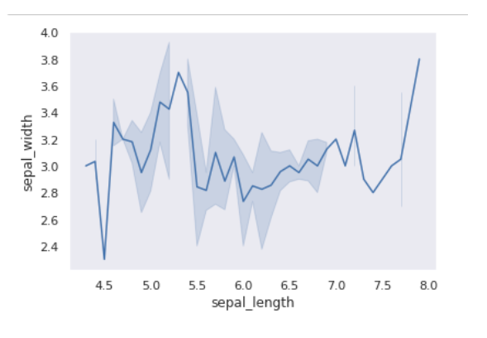
# importing packages
import seaborn as sns
import matplotlib.pyplot as plt
# loading dataset
data = sns.load_dataset("iris")
# draw lineplot
sns.lineplot(x="sepal_length", y="sepal_width", data=data)
# changing the theme to dark
sns.set_style("dark")
plt.show()

Slide 13
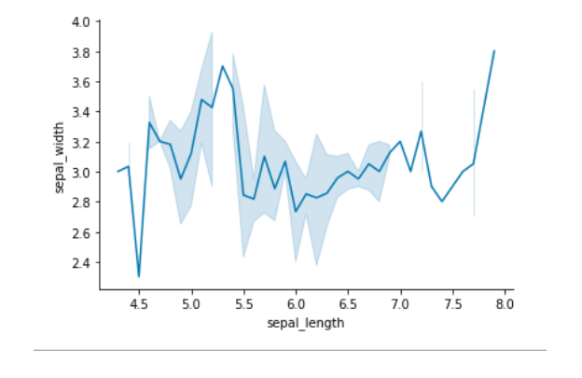
Removal of Spines
Spines are the lines noting the data boundaries and connecting the axis tick marks. It can be removed using the despine() method. (top and right borders)
Syntax: sns.despine(left = True)
# importing packages
import seaborn as sns
import matplotlib.pyplot as plt
# loading dataset
data = sns.load_dataset("iris")
# draw lineplot
sns.lineplot(x="sepal_length", y="sepal_width", data=data)
# Removing the spines
sns.despine(left=‘True’) # left,right,top,bottm with True or False we can use
plt.show()

Slide 14
Pairplot() in seaborn
seaborn.pairplot() method is used for visualizing relationships between multiple variables in a dataset. By creating a grid of scatter plots it helps to identify how different features interact with each other to identify patterns, correlations and trends in data.
Syntax: seaborn.pairplot(data, **kwargs)
Here data refers to the dataset we want to visualize and kwargs represent additional optional parameters that can be customized for different visualizations.

Slide 15
Arguments | Description | Value
data | Dataframe where each column is a variable and each row is an observation. | DataFrame
hue | Variable in data to map plot aspects to different colors. | string (variable name), optional
palette | Set of colors for mapping the hue variable. Can be a dictionary for custom color mapping | dict or seaborn color palette
{x, y}_vars | Allows you to specify which variables to use for the rows and columns of the plot to create a custom layout. | lists of variable names, optional
dropna | Drop missing values from the data before plotting. | boolean, optional

Slide 16
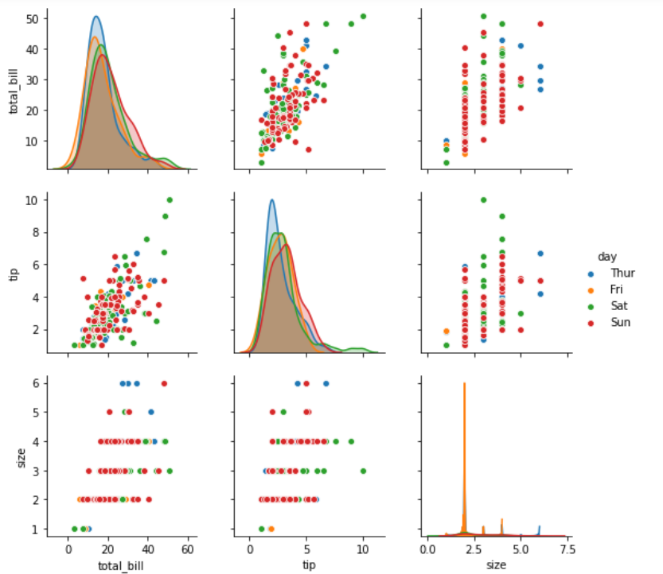
Pairplot with Hue by Day:
We will use hue parameter to color-code points based on the day column. This helps to distinguish between different days of the week.
  import seaborn
  import matplotlib.pyplot as plt
  df = seaborn.load_dataset('tips')
  seaborn.pairplot(df, hue ='day')
  plt.show()
A grid of scatter plots showing the relationships between the numerical features in the tips dataset with color coding based on the day column is formed.

Slide 17
Pairplot with Custom Palette by Sex
We will use the hue and palette parameter to color-code points based on the sex column helps in distinguishing between male and female customers. Here we defined colour palette as blue and pink using custom_palette.
import seaborn
import matplotlib.pyplot as plt
df = seaborn.load_dataset('tips')
custom_palette = {'Male': 'lightblue', 'Female': 'pink'}
seaborn.pairplot(df, hue='sex', palette=custom_palette)
plt.show()
We can map colors to categorical variables not for the numeric values

Slide 18
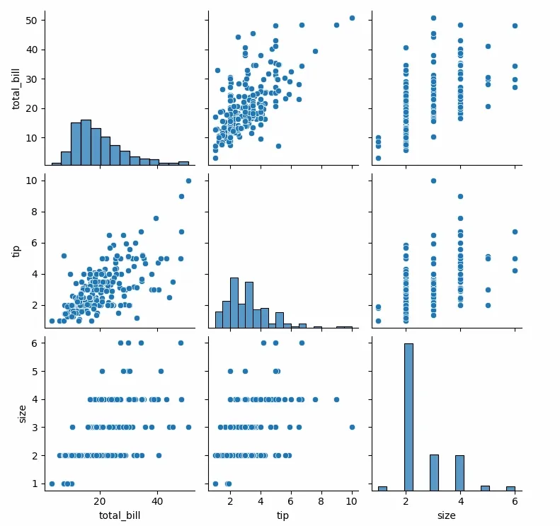
Pairplot with Specific Variables:
We can focus on specific variables in the tips dataset. Here we visualize only the total_bill, tip and size features using {x, y}_vars parameter.
import seaborn
import matplotlib.pyplot as plt
df = seaborn.load_dataset('tips')
seaborn.pairplot(df[['total_bill', 'tip', 'size']])
plt.show()

Slide 19
KDE Plot Visualization with Pandas and Seaborn
KDE Plot described as Kernel Density Estimate is used for visualizing the Probability Density of a continuous variable. It depicts the probability density at different values in a continuous variable. We can also plot a single graph for multiple samples which helps in more efficient data visualization. In this article, we will be using Iris Dataset and KDE Plot to visualize the insights of the dataset.
Syntax:
seaborn.kdeplot(x=None, *, y=None, vertical=False, palette=None, **kwargs)
x, y : vectors or keys in data
vertical : boolean (True or False)
data : pandas.DataFrame, numpy.ndarray, mapping, or sequence

Slide 20
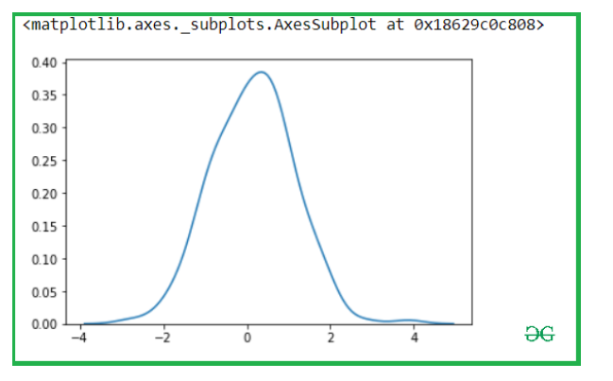
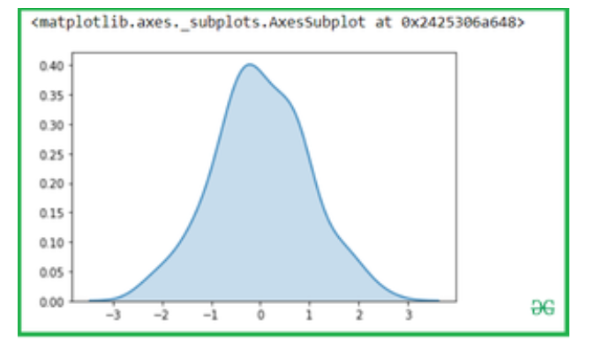
x= np.random.randn(200)
y = np.random.randn(200)
# Kde for x var
sns.kdeplot(x)
Use Shade to fill the area covered by curve:
We can highlight the plot using shade to the area covered by the curve. If True, shadow processing is performed in the area below the kde curve, and color controls the color of the curve and shadow
sns.kdeplot(x, shade = True)

Slide 21
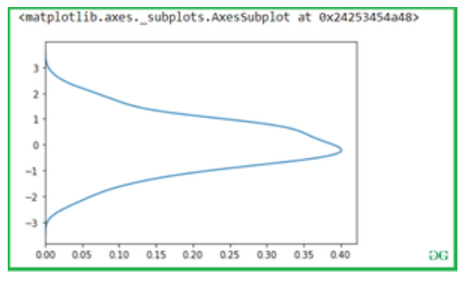
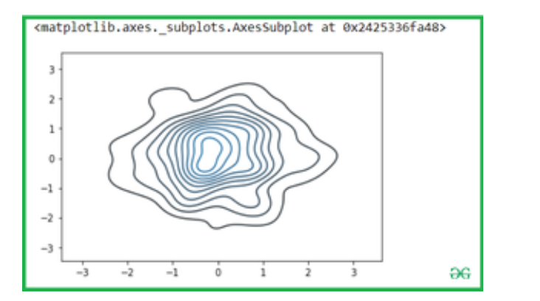
sns.kdeplot(x, vertical = True)
Bivariate Kdeplot for two variables:
Simple pass the two variables into the seaborn.kdeplot() methods.
Syntax:
Sns.kdeplot(x,y)

Slide 22
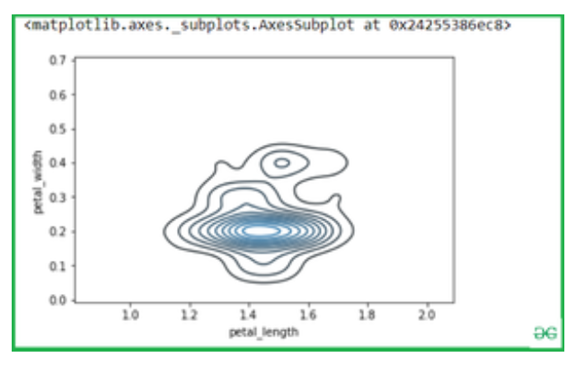
setosa = iris.loc[iris.species=="setosa"]
virginica = iris.loc[iris.species == "virginica"]
sns.kdeplot(setosa.petal_length, setosa.petal_width)

Slide 23
Seaborn Distribution plots:
Seaborn is a Python data visualization library based on Matplotlib. It provides a high-level interface for drawing attractive and informative statistical graphics. This article deals with the distribution plots in seaborn which is used for examining univariate and bivariate distributions.
joinplot
distplot
Displot
It is used basically for univariant set of observations and visualizes it through a histogram i.e. only one observation and hence we choose one particular column of the dataset.
Syntax: distplot(a[, bins, hist, kde, rug, fit, ...])

Slide 24
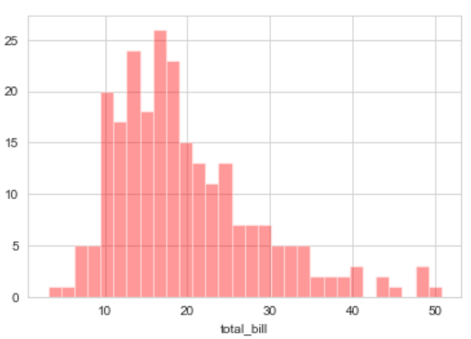
# set the background style of the plot
sns.set_style('whitegrid')
# set the background style of the plot
sns.set_style('whitegrid')
sns.distplot(df['total_bill'], kde = False, color ='red', bins = 30).
Explanation:
KDE stands for Kernel Density Estimation
and that is another kind of the plot in seaborn.
bins is used to set the number of bins you
want in your plot and it actually depends on
your dataset.
color is used to specify the color of the plot
Now looking at this we can say that most of
the total bill given lies between 10 and 20.

Slide 25
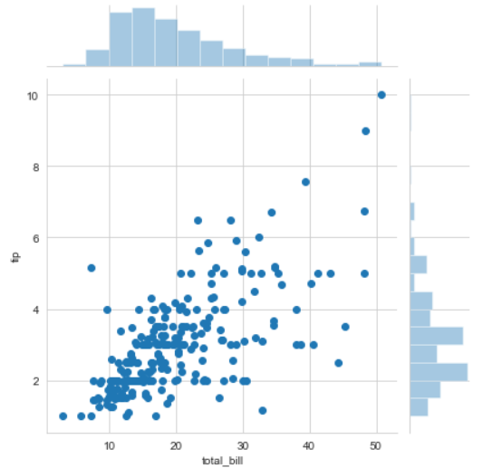
Jointplot
It is used to draw a plot of two variables with bivariate and univariate graphs. It basically combines two different plots.
Syntax: jointplot(x, y[, data, kind, stat_func, ...])
Example: sns.jointplot(x ='total_bill', y ='tip', data = df)
Explanation:
kind is a variable that helps us play around with the fact as to how do you want to
visualise the data.
It helps to see whats going inside the joinplot.
The default is scatter and can be hex, reg(regression) or kde.
x and y are two strings that are the column names and the data that column contains is
used by specifying the data parameter.
here we can see tips on the y axis and total bill on the x axis as well as a linear relationship between
the two that suggests that the total bill increases with the tips.
  hue sets up the categorical separation between the entries if the dataset.
  palette is used for designing the plots.

Slide 26
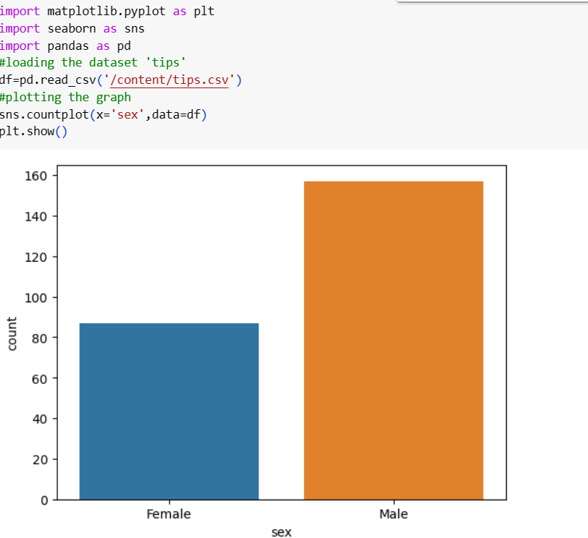
Countplot:
The countplot is used to represent the occurrence(counts) of the observation present in the categorical variable.
It uses the concept of a bar chart for the visual depiction.
Value counts for a single variable:we will create a countplot for a single variable. We have taken the dataset 'tips' to implement the same.

Slide 27
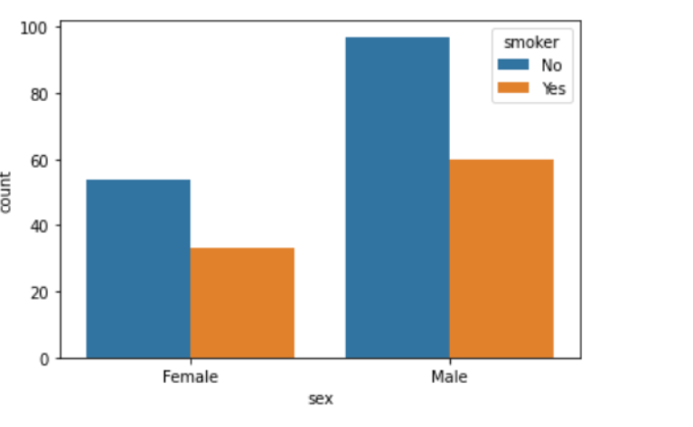
2. Representing two categorical variables using hue parameter
import matplotlib.pyplot as plt
import seaborn as sns
import pandas as pd
#loading the dataset 'tips'
df=pd.read_csv("/content/tips.csv")
#plotting the graph
sns.countplot(x='sex',hue='smoker',data=df)
plt.show()

Slide 28
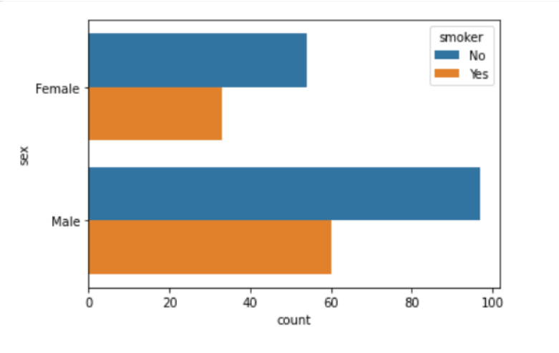
3. Creating Horizontal Plots
import matplotlib.pyplot as plt
import seaborn as sns
import pandas as pd
#loading the dataset 'tips'
df=pd.read_csv("/content/tips.csv")
#plotting the graph
sns.countplot(y='sex',hue='smoker',data=df)
plt.show()

Slide 29
REFERENCES FOR FURTHER LEARNING OF THE SESSION
Text Books:
Introduction to Data Science- A Structured Methodology,Goran trajkovski.
Data Science from Scratch- Joel Grus - O’Reilly - 2015
Practical Statistics for Data Scientists - Peter Bruce, Andrew Bruce & Peter Gedeck - O’Reilly - 2020
Data Science and Machine Learning (Mathematical and Statistical Methods) - Dirk P. Kroese, Zdravko I. Botev, Thomas Taimre, Radislav Vaisman- Chapman and Hall/CRC - 2025
Foundations of Data Science - Avrim Blum, John Hopcroft, and Ravindran Kannan - Cambridge University Press – 2020
Reference Books:
R1.Data Science and Its Applications by Aakanksha Sharaff and G. R. Sinha.
R2. Introducing Data Science Big Data, Machine Learning, and more using Python tools. by Davy cielen, Arno D.B. Meysman and Mohamed Ali.

Slide 30

THANK YOU
Team – DS

